Slide 1
LED App Project
By: Suryateja Addagarla

Slide 2
Content
Purpose
UML diagram
Everyday Scenario

Slide 3
Purpose
Made an app that tells what audio is being played and what number is pressed
Has 2 front-end and 1 back-end platforms
Prototype of making an IoT and IT small app

Slide 4
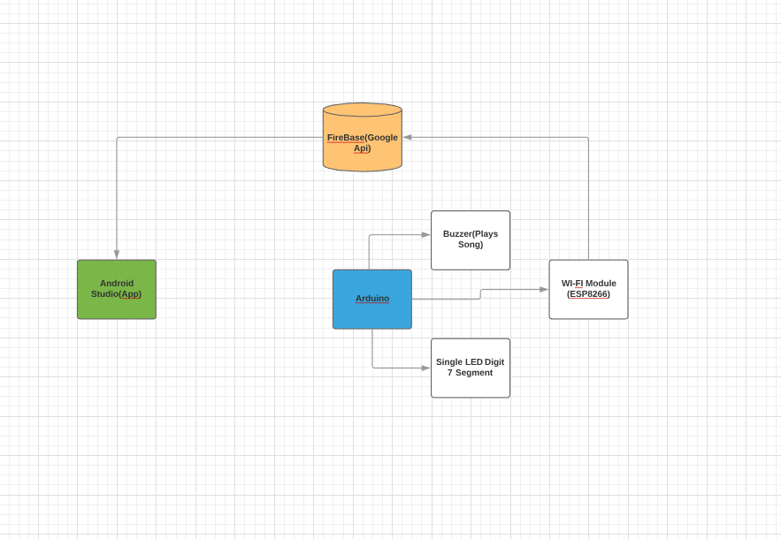
UML Diagram

Slide 5
Everyday Scenario
Airport flight timings when your on the way to the airport
App that tells you if any IoT product is online or not
App that tells you if your hardware (servers) are online or not

Slide 6
Thank You!!!

